Slide 1
Root Cause Analysis (RCA)of Bull Gear & Pinion failure
Sher Khan Khoso
Dy: Chief Engineer
Matiari Sugar Mills Ltd.

Slide 2
INTRODUCTION
Steady and smooth operation of process is a big achievement to enhance overall profit of organization;
To break the continuity of process due to deterioration of Equipment suffered the overall profitability.
This deterioration of equipment happened due to without discovering and to root out cause of equipment failure
It is essential to find out RCA of equipment failure to build steady & smooth operation of process.

Slide 3
Root Cause Analysis (RCA)
RCA is a technical and operational tool to analyse, detect and formally establish of failures.
RCA plays an important role in any organization to improve process cycle time.
The purpose of any RCA is to find effective solutions to problem such that they do not reoccur.

Slide 4
Procedure to do RCA
Step-1
Define the problem /failure
Step-2
Data Collecting
Step-3
Identify possible causes/factors
Step-4
Define the root cause
Step-5
Recommended solutions

Slide 5
Case study to find out RCA of Gear Failure in MSM
In 2017 Matiari Sugar Mill enhanced the overall capacity of plant from 4000 TCD to 5000 TCD. Consequently all mill’s low speed single helical gears were replaced with double helical gears.
Specification
Gear type | Double Helical (Single Stage low-speed Gear)
Designed power | 650 kW
Module | 20
Helix Angle | 30o
Reduction ratio | 1:9 (Gear teeth = 171, Pinion teeth =19)
Face width | 650 mm

Slide 6
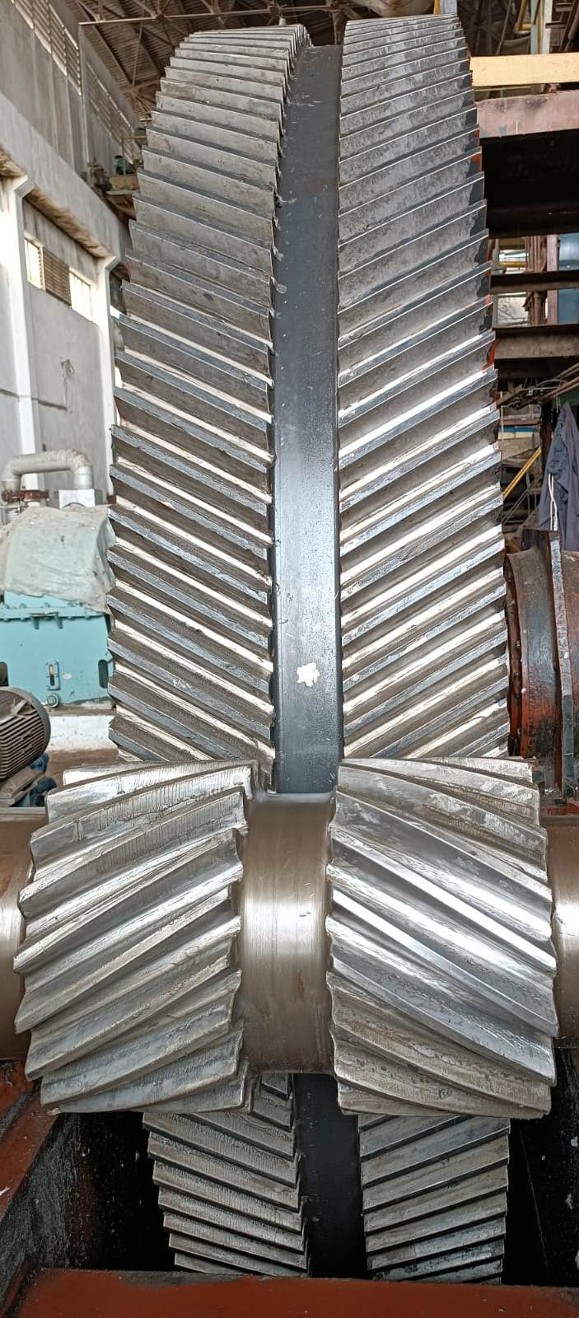
Double Helical VS Single Helical Gear
Advantages
Transmit more power
Higher efficiency
No thrust load produced
MSM Double Helical Gear

Slide 7
Double Helical Gear VS Single Helical Gear
Disadvantages
Costlier, complex in design and fabrication
Single Helical Gear is easier to adjust two tooth flanks instead of four.
Highly accuracy required in Gear alignment.
Chances of producing external thrust may over load one helix leading to possible damage.
MSM Double Helical Gear

Slide 8
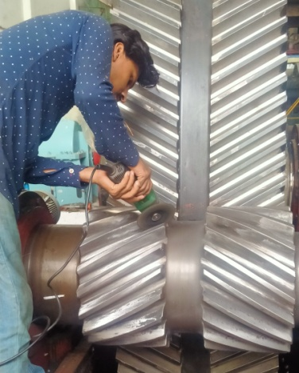
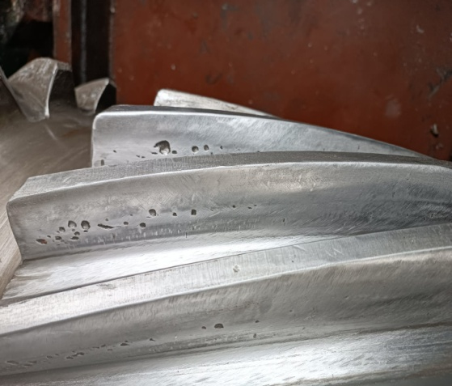
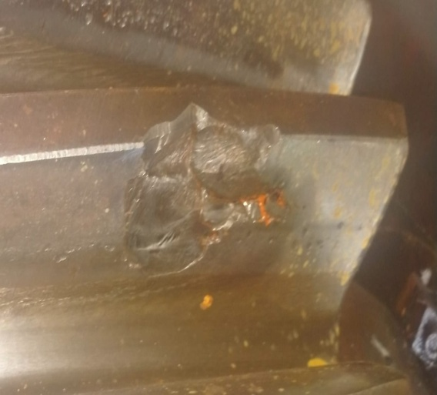
Step-1 :To identify the failure
Failure observed from first day of gear installation, because mismatching of gear teeth (uneven contact & backlash) picture-1
Localized initial pitting started earlier at the start of first season and to continue get increases to destructive/progressive pitting picture-2
Pitch line surface fatigue spelling observed also on some pinion gears as shown in picture-3
Picture-1 | Picture-2 | Picture-3

Slide 9
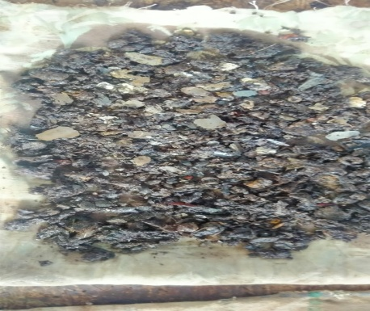
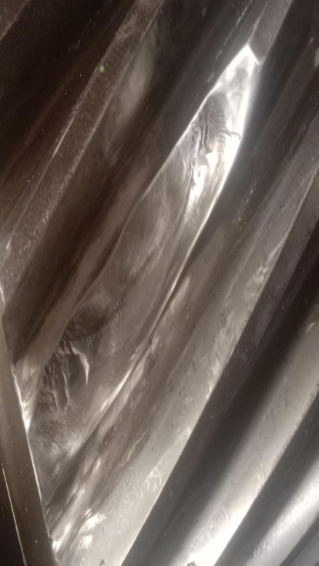
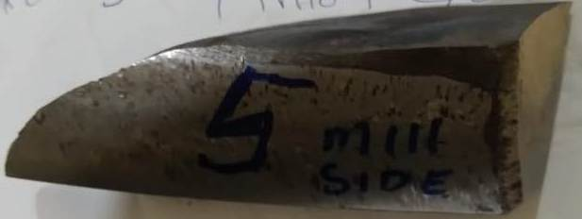
Step 1: To identify the failure
Initial pitting also increases on pinion teeth due to light broken particles of pinion teeth present in lubrication oil.
Several teeth’s of pinion Gear Broken Because of progressive pitting and fatigue load of Mills as shown below picture

Slide 10
Step2: Collect the data
Maintaining records of failure and break down of equipment in process organization is very essential, to help check the performance of equipment and prevent frequent deterioration of equipment.
The first tooth of low speed gear on mill#2 broken after only 30 working days.
After first working season in off-season detail inspection of all low speed gears (bull gear and pinion) initial and progressive pitting observed on all pinion gears.
In off-season 2018, 2019 and 2020 continuous destructive pitting observed on pinion and bull gear teeth.
last season one tooth of mill#4 and mill#5 broken.

Slide 11
Step3: Identify possible causes/factors
Material Analysis of broken teeth of gears from out source.
Hardness test of Gears
Dye penetrate test of Gears
Checking teeth contact of pinion and bull gear (log) by applying red lead powder.
Checking and inspection of mill and low speed gear leveling and alignment.

Slide 12
Step3: Identify possible causes/factors (Cont..)
Material Analysis (Test method ASTM E-415 & E-1019) of broken pieces of pinion teeth, samples have been analyzed by Optical Emission Spectrometer & carbon and sulfur analyzed by Rapid Analyzer from People steel mill.
Chemical composition of broken teeth material found satisfactory according to standard either recommendation of OEM.
Sample | Chemical Composition Wt.%
 | Element | C | Si | Mn | P | S | Cr | Mo | Ni | Cu
1 | Actual | 0.43 | 0.45 | 0.73 | 0.016 | 0.015 | 0.94 | 0.18 | 0.28 | 0.22
2 | - | 0.37 | 0.30 | 0.71 | <0.01 | 0.012 | 1.01 | 0.17 | 0.22 | 0.16
3 | - | 0.41 | 0.41 | 0.74 | <0.01 | 0.017 | 0.15 | 0.15 | 0.25 | 0.16
4 | - | 0.37 | 0.48 | 0.70 | 0.011 | 0.010 | 0.20 | 0.20 | 0.22 | 0.19

Slide 13
Step3: Identify possible causes/factors (Cont…)
Hardness Test: Hardness test was performed by outsource team at site on random teeth of bull gear and pinion of mill#1-5, average results as follows ,
OEM recommended hardness of teeth should be 310 BHN – 320 BHN,
It is notice that hardness on teeth of all gears is not consistent.
Mill # | Bull gear | Pinion
 | HB | HB
1 | 280 | 310
2 | 240 | 290
3 | 260 | 300
4 | 250 | 330
5 | 250 | 330

Slide 14
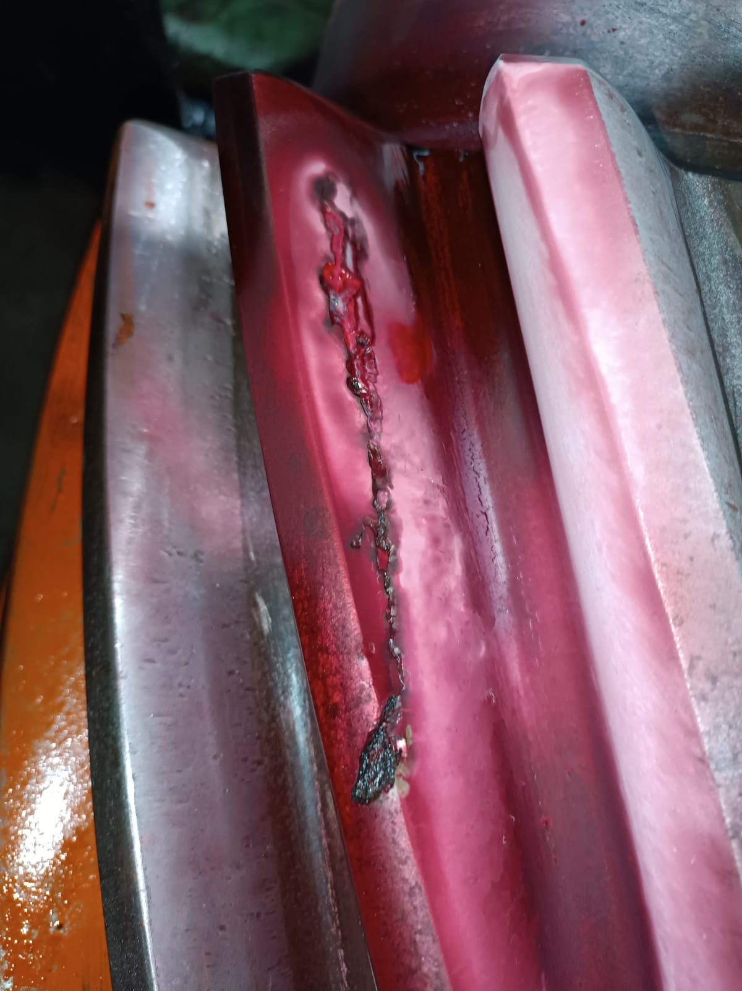
Step3: Identify Possible Causes/factors (Cont…)
Die penetrate or liquid penetrate testing is used to detect the presence of surface cracks in gears.
The penetrate kit basically consist of three chemicals in pressurized cans namely Cleaner, Penetrate and Developer.
Very easy procedure to perform DPT, first clean the surface of cracked gear teeth second sprayed the penetrate liquid on cracked gear teeth remove extra penetrate liquid and last apply developer to the crack teeth surface, after that the crack on gear teeth will be visible.
On MSM site DIP test performed as shown in picture various major and minor cracks observed on pinion gears.

Slide 15
Step4: Define the Root Cause
Various causes of low speed gear (Bull gear and pinion) failure observed
Before installation on place observed pin holes on the pinion and bull gear teeth
Mismatching (uneven backlash) in teeth’s of gears observed at time of installation
Variation in hardness of teeth surface
Sudden high impact load from mill side due to un-even lift of mills

Slide 16
Step5: recommended and implement solution
A Local Vendor and MSM team jointly recommended to avoid Gear Failure
To re-cut teeth profile of all Bull Gears with standard 20 module Hob cutter for uniform thickness, profile and smooth surface to avoid uneven contact and backlash of Gear teeth.
To install Multi misalignment coupling (Rope Coupling) instead of conventional Tail bar and coupling arrangement to avoid axial loads and high impact load from mill side.
Replace lubrication oil of all gears avoid pitting on gears due to abrasive particles and higher viscosity lubricant recommended.

Slide 17
Conclusion
Root cause analysis in basic need of process organization to improve process cycle time.
Double helical gears as compare single gear are complex in gear alignment ,teeth contacts and more chance of gear failure.
RCA help in deep understanding of problem for better solution.

Slide 18
Thank You

